Slide 1

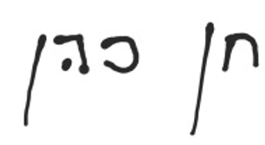

Project Work Plan
Project Number:3221
Project Name:Optical Fibers for Smart Cities
IoT-enabled fiber optic sensing for real-time road anomaly detection and urban monitoring (2025–2026)
Students:
Noa Sapir- 208744086
Nitai Dobrecki-
Project carried out at:Faculty of Electrical Engineering, Tel Aviv University
For the project instructor:
I approve the submission of the following report
_____________ Signature:
Khen Cohen_______Name :

Slide 2


Abstract
Project Background
Technologies Used
The project aims to track vehicles across multiple streets, estimate speed, and identify abnormal driving events in real time by developing a multi-sensor traffic-monitoring system
The system integrates optical-fiber vibration sensing (DAS), computer-vision detections, and satellite-based GPS timing, which enables traffic monitoring under different weather, visibility, and environmental conditions.
Relevance
Overview
By leveraging existing communication fibers, the system can provide continuous coverage without adding roadside hardware.
The project includes multi-street simulation, DAS signal preprocessing, feature extraction, cross-street event matching, Kalman-based sensor fusion, and anomaly detection.
Simulation
Detection
Matching
Fusion
Deliverables

Slide 3
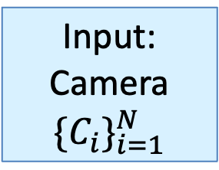
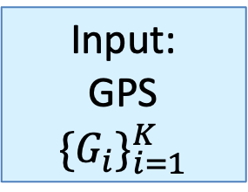
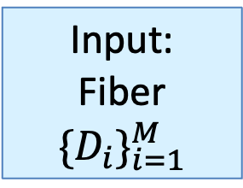
System Overview – Block Diagram
Input: Camera
$${\{C_{i}\}}_{i=1}^{N}$$
Data Accuracy
&
Kalman Filter
Data Processing and Analysis Module
Input:
Fiber
$${\{D_{i}\}}_{i=1}^{M}$$
Merging
Input:
GPS
$${\{G_{i}\}}_{i=1}^{K}$$
Geophysics
Analytics Outputs

Slide 4
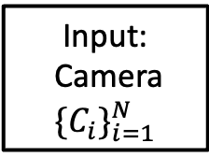
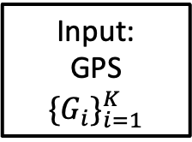
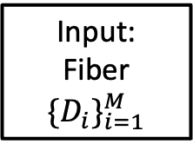
System Overview – Block Diagram
Input:
Camera
$${\{C_{i}\}}_{i=1}^{N}$$
Input:
Fiber
$${\{D_{i}\}}_{i=1}^{M}$$
Data Accuracy
&
Kalman Filter
Data Processing and Analysis Module
Analytics &
Statistics Outputs
Data Merging
Geophysics
Input:
GPS
$${\{G_{i}\}}_{i=1}^{K}$$

Slide 5


motivation
The rapid rise of smart cities demands advanced sensing systems to improve traffic management and emergency response. This project integrates fiber-optic sensing, visual data, and GPS into a unified framework to estimate traffic speed and density and uses neural networks to detect anomalies like sudden stops, wrong-way driving, and accidents in real time.
comparison to existing alternatives
OptaSense (UK):
Uses Distributed Acoustic Sensing (DAS) along fiber cables to detect and classify vehicles on single road segments. However, it lacks multi-sensor integration and cross-street tracking. Our system extends this by fusing DAS with GPS and cameras for multi-segment tracking and real-time anomaly detection.
Miovision (Canada):
Provides AI-based traffic monitoring through smart cameras that manage flow and intersections but is limited by weather and lighting conditions. Our approach combines fiber-optic sensing with vision and GPS for continuous, weather-independent monitoring and enhanced reliability across wider urban areas.
scientific and engineering reasonings
Scientifically, the project advances multi-sensor fusion for spatiotemporal signal analysis, while engineering-wise, it showcases a scalable way to turn communication networks into intelligent urban sensors.
importance & contribution
Traditional monitoring tools like cameras and GPS offer useful data but are constrained by visibility, coverage, and reliability under changing conditions. In contrast, fiber-optic systems deliver continuous spatial coverage over long distances without extra roadside equipment, reducing maintenance costs and enabling scalable city-wide deployment.

Slide 6
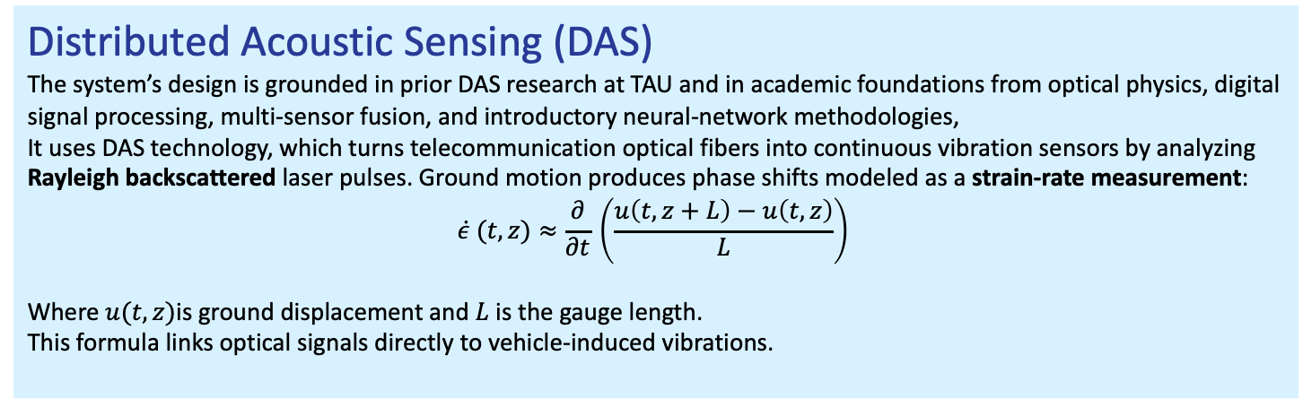
Statement Of Work
Distributed Acoustic Sensing (DAS)
The system’s design is grounded in prior DAS research at TAU and in academic foundations from optical physics, digital signal processing, multi-sensor fusion, and introductory neural-network methodologies,
It uses DAS technology, which turns telecommunication optical fibers into continuous vibration sensors by analyzing Rayleigh backscattered laser pulses. Ground motion produces phase shifts modeled as a strain-rate measurement:
$$\dot{ε} (t,z)≈\frac{∂}{∂t}​\left(\frac{u\left(t,z+L\right)−u\left(t,z\right)​}{L}\right)$$
Where$u(t,z)​$is ground displacement and $L$is the gauge length.
This formula links optical signals directly to vehicle-induced vibrations.
Signal Processing & Event Detection
Raw DAS channels undergo filtering, noise suppression, envelope extraction, and feature-based event detection to isolate vehicle signatures from ambient vibrations.
Geophysical Modeling
Vehicle movement generates surface waves that propagate through asphalt and soil. Modeling these patterns enables realistic multi-street simulations and speed estimation via inter-channel delays.

Slide 7
Statement Of Work
Multi-Sensor Hardware Integration
The system combines three sensing modalities:
Fiber-optic DAS for vibration sensing
Cameras for visual detection and ground truth
GPS for timing alignment and speed measurement
Sensor Fusion
A Kalman filter fuses the measurements into a unified state, enabling consistent cross-street tracking and trajectory reconstruction.
AI Analytics & Monetization Layer
The system’s fused DAS–camera–GPS data enables an additional ml-based layer for anomaly detection and alerting.
A model identifies events such as over speeding, sudden stops, and irregular vibration patterns, and visualizes them on a monitoring dashboard.

Slide 8
Quantitative Metrics & Performance Targets
≥90%
≥5 / 10
≥90%
≤60 sec
Cross-Street Accuracy
Detected Anomalies
Kalman Fusion Success Rate
End to End Latency
Detection & Tracking Accuracy
  Achieve ≥90% accuracy in matching vehicle events across 2–5 adjacent street segments using fused DAS, GPS, and camera data.
Baseline: ~70% association accuracy (prior single-sensor DAS projects).
Target: ≥90% after multi-sensor fusion and improved feature extraction.
Validation: simulation-generated ground truth + camera-based labeling.
Anomaly Detection Reliability
  Detect ≥5 / 10 simulated anomalies in Phase A:
  over speeding, sudden stops, congestion, irregular vibration patterns, and wrong-way driving.
Baseline: no existing anomaly detection module.
Phase B target: >80% anomaly-detection accuracy after dataset expansion.
Sensor Fusion Performance
  Maintain ≥90% correct sensor association using Kalman-based fusion.
Speed estimation error:
≤ ±5 km/h using DAS timing + GPS reference.
Support up to 10 simultaneous vehicles across multiple street segments.
Processing Pipeline Latency
  Full processing pipeline (simulation → detection → matching → fusion → outputs) completed within ≤60 seconds.
Per-event processing: ≤ 3 seconds.
DAS preprocessing (filter + envelope): ≤ 10 seconds per segment.
Scalability: simulation supports up to 5 connected street segments.

Slide 9






Tools, Environment , Hardware and Expected Outcomes
Software & Development Tools
Python for all algorithmic development
NumPy, SciPy for digital signal processing and geophysical modeling
Pandas for event tables and dataset generation
PyTorch for anomaly detection
Jupyter Notebooks
Matplotlib for visualization
Simulation Environment
based on previous TAU DAS research
Multi-street traffic simulation
DAS strain-rate signals
Controller for vehicle motion, timing offsets, noise levels, and anomaly injection.
Simulated camera detections and GPS traces for multi-sensor fusion
Ground-truth labeling
Hardware
Fiber-optic DAS interrogator (simulated)
Virtual camera nodes for visual ground truth
Virtual GPS module for speed and timing reference
Acsses to the students projects manegment servers for GPU training.
Simulation results
Realistic multi-street simulations generating DAS signals, camera detections, GPS traces, and ground-truth labels, enabling validation of event detection, matching accuracy, and speed estimation.
Neural network anomaly detection outcomes
A lightweight model trained on labeled simulated events to identify anomalies such as overspeeding, sudden stops, congestion, and irregular vibration patterns with measurable performance metrics.
Live dashboard with Emergency alerts outcomes
A visualization interface displaying detected events, fused trajectories, and anomaly alerts in real time, supporting rapid situational awareness and potential integration into smart-city monitoring systems.

Slide 10
Project Schedule
Milestone | One-Line Description | Planned Date
Scenario Definition | Define all traffic scenarios (vehicle types, speeds, routes). | Dec 15, 2025
Simulation Environment Build | Build multi-street map + sensor placement (DAS + Camera + GPS). | Dec 30, 2025
DAS Signal Pipeline | Filtering, noise modeling, envelope extraction. | Jan 15, 2026
Simulation of Traffic Events | Generate synthetic DAS signals from the defined scenarios. | Jan 30, 2026
Camera + GPS Emulation Layer | Produce synchronized camera/GPS outputs for all scenarios. | Feb 25, 2026
Progress Presentation (Semester A) | Submit and present all Semester A simulation results. | Mar 10, 2026
Event Detection v1 | Detect traffic-induced events from simulated DAS signals. | Mar 30, 2026
Cross-Street Association | Match detected events across segments using timing/features. | Apr 10, 2026
Fusion Model Design | Define Kalman filter structure and sensor measurement models. | Apr 25, 2026
Fusion Implementation | Integrate DAS + camera + GPS into a unified state estimate. | May 15, 2026
Fusion Evaluation | Compare the estimated vehicle path with the ground-truth GPS path. | June 2, 2026
Anomaly Dataset Generation | Create labeled anomalies (overspeeding, stops, congestion). | June 17, 2026
Performance Tuning | Optimize latency, accuracy, and fusion/anomaly performance. | June 30, 2026
Anomaly Detection Algorithm | Train and validate anomaly detection methods. | July 10, 2026
Final Deliverables | Submit final report, code, datasets, and presentation. | Aug 20, 2026

